Slide 1

FOSS4G NA Workshop: Exploring Multimodal LLMs for Remote Sensing with LibreGeoLens
November 3rd, 2025
Pedro Uria, David Siamon, Nicholas Harvey
Vibrint ML Team

Slide 2
Agenda
Greetings, Intros, Agenda, Install QGIS if needed (1:00)
Intro to LibreGeoLens (LGL) & presentation on MLLMs (1:05)
Brief pause for Q&A (1:15)
LGL’s intended purpose & live demo (1:20)
LGL installation & quickstart follow-along (1:30)
LGL’s features (1:40)
Guided lab #1: setting up cloud-based MLLM services (1:50)
Break + Q&A (2:00)
Guided lab #2: setting up self-hosted MLLM services (2:10)
Guided lab #3: COG streaming (2:55)
Break + Q&A (3:10)
Time to explore use cases and share results (3:20)
Future plans, feedback & ideas (3:50)

Slide 3
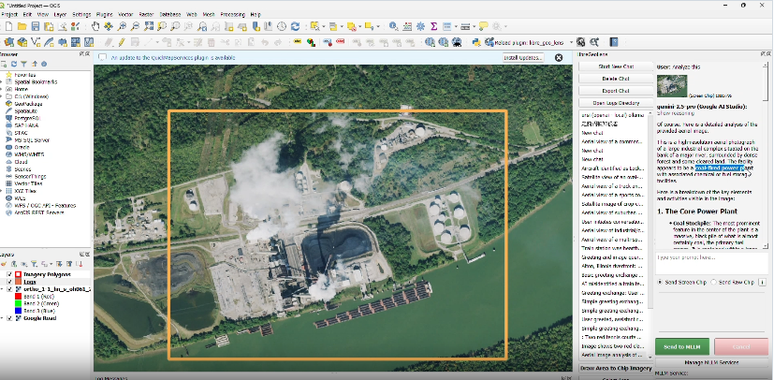

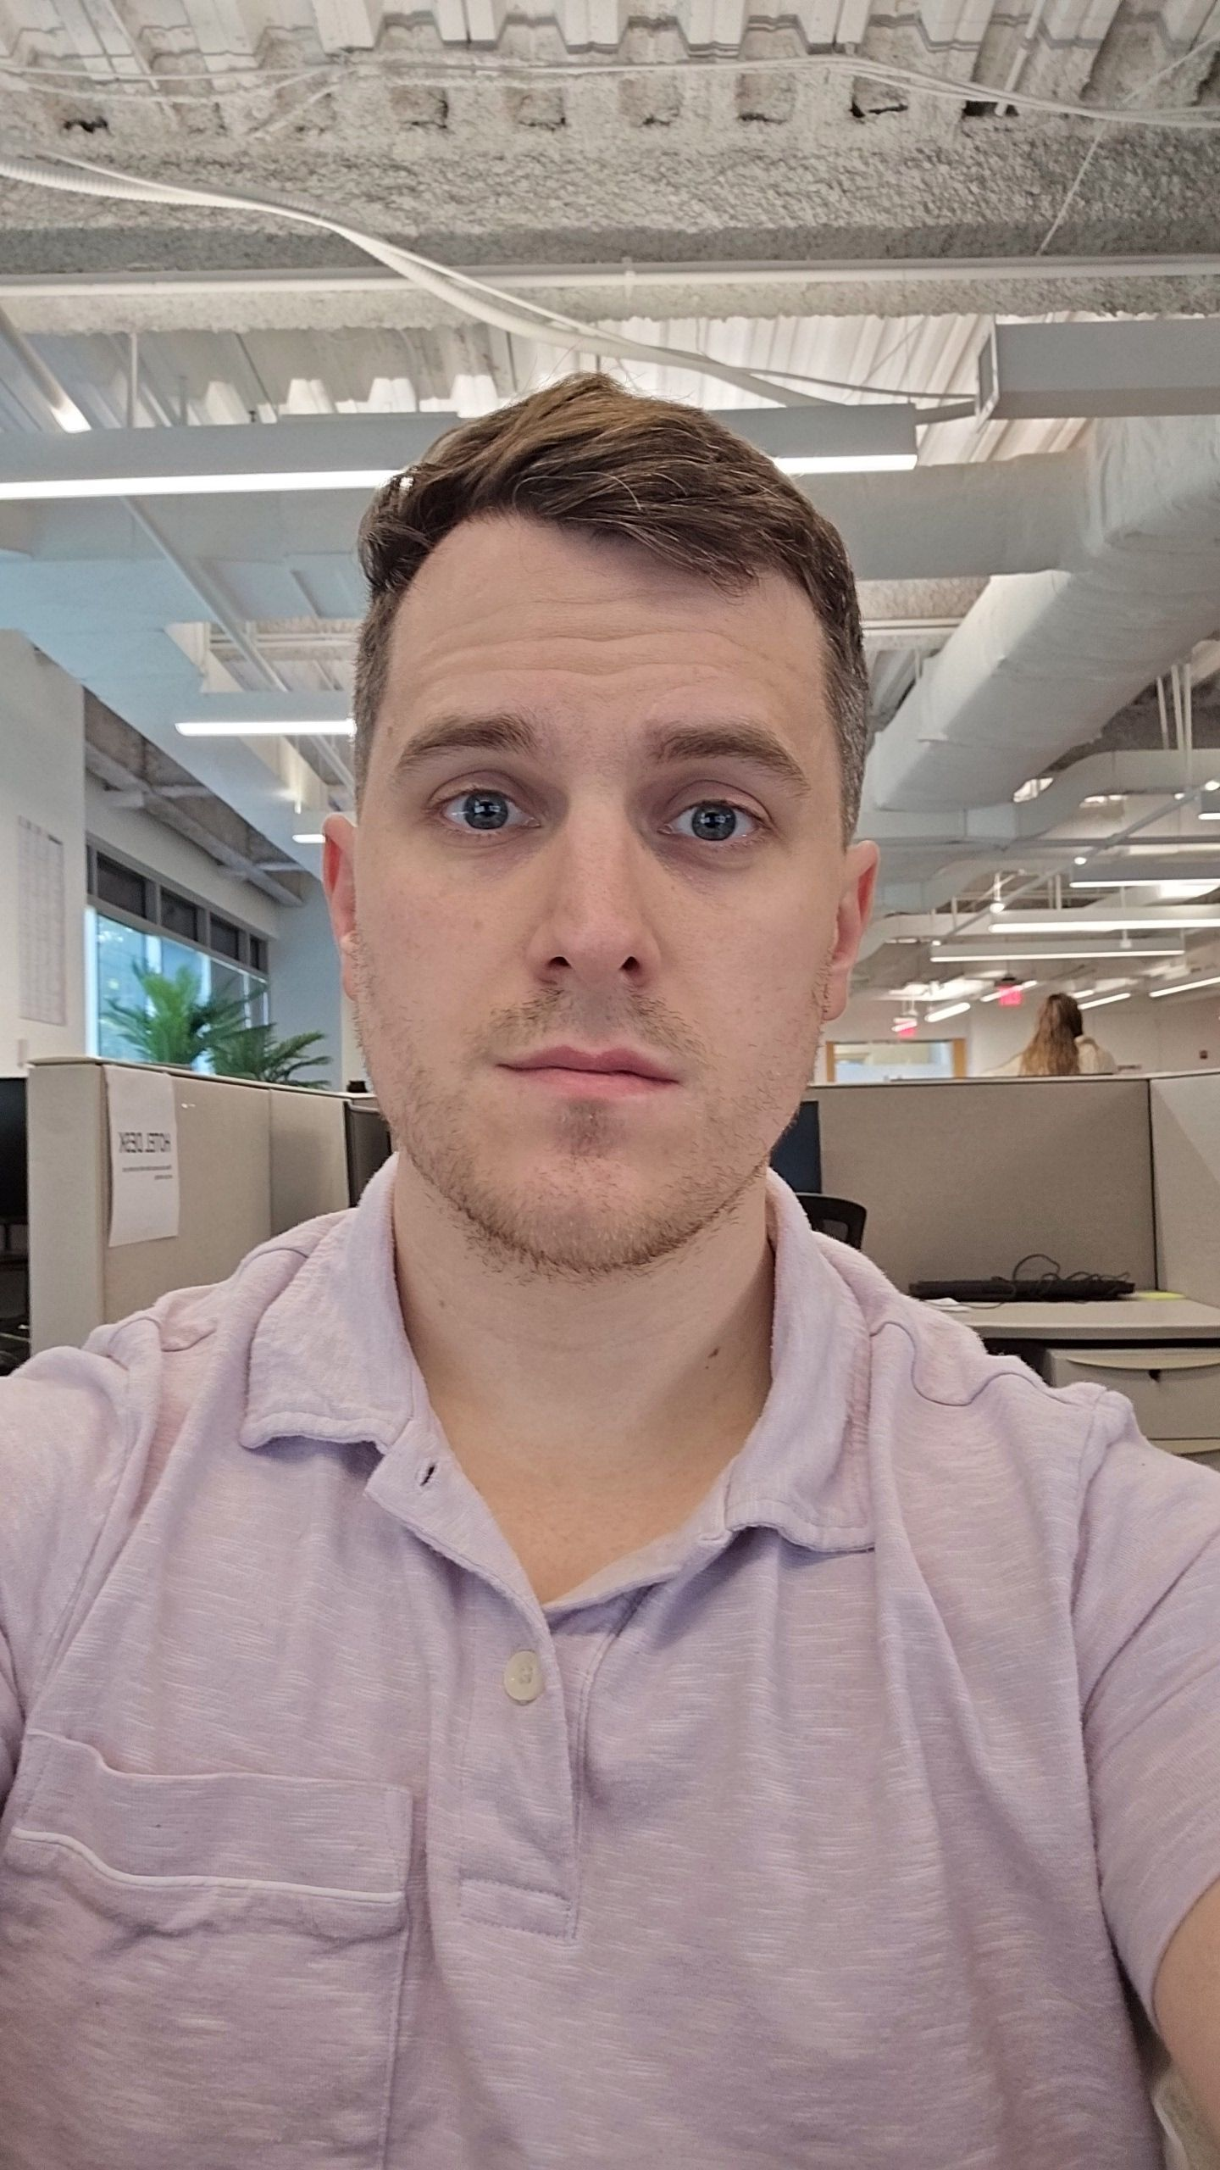
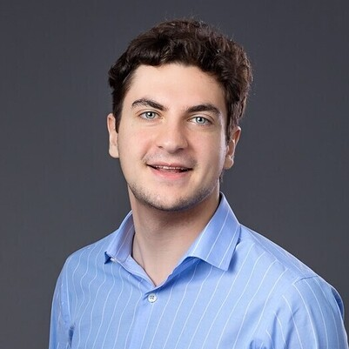
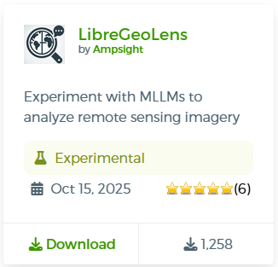

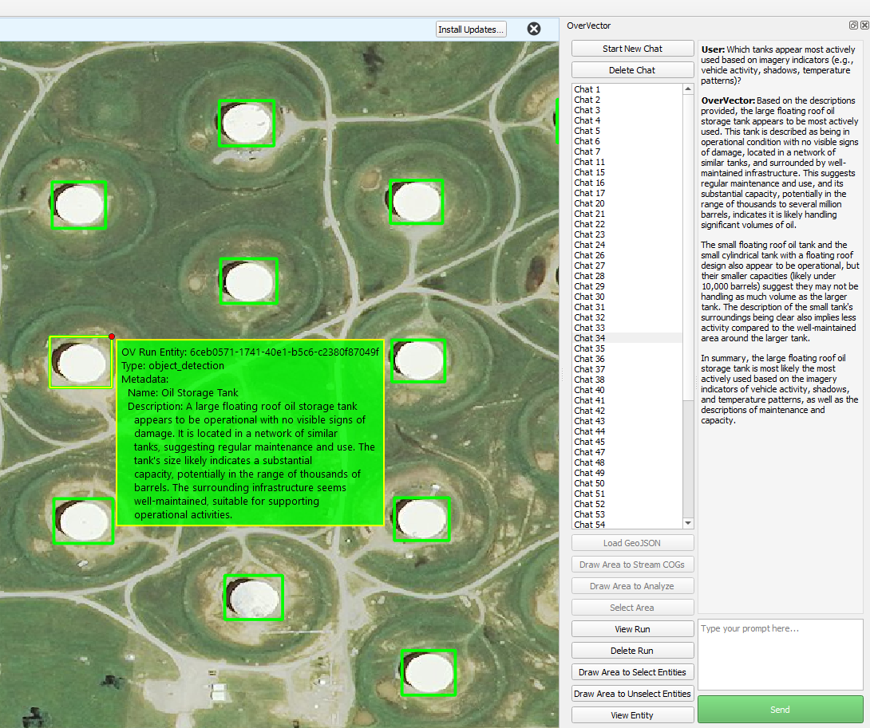

Contact Us
Open-Source
QGIS Plugin
NICK HARVEY
Data Scientist
nicholas.harvey@vibrint.com
DAVID SIAMON
AI/ML Engineer
david.siamon@vibrint.com
PEDRO URIA
Data Scientist
pedro.uria@vibrint.com
An AI assistant to help you analyze remote sensing imagery

Slide 4
Thank you

